Slide 1
Mobile Computing
Assignment 1
Mobility ManagemENt
(Peersim Simmulation)
Abid Waqar ( i160229 )
Govinda Kumar ( i160249 )
Nauraiz Mushtaq ( i160106 )
Section Z

Slide 2
Analysis and Evaluation: Results.
Analytical part is done in Python because of its higher level libraries that are easy to manipulate such as pandas, numpy and matplotlib.
Analysis caters graphs using matplotlib library pyplot.
Provided traces had been loaded in the form of data frame from using pandas.

Slide 3
Update message Journey:
IF node’s location area changes then:
Node send message to old VLR to remove node’s entry from its database.
Node send message to new VLR to add node’s entry in its database.
New VLR send message to HLR to notify the change.

Slide 4
Search Message Journey:
IF node is searched then:
Message request goes to HLR
HLR checks node’s entry and if found then it sends message to Its VLR.
VLR pages in its location area by sending request to all its nodes.
All nodes except searched node ignores search message, and searched node, if its active, sends search reply with its coordinates back to VLR.
VLR sends this search Reply back to HLR.
HLR send this search reply back to the node which initiated search.

Slide 5
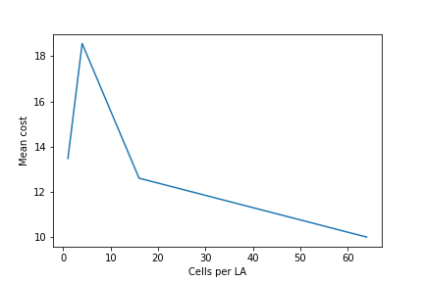
Analysis and Evaluation: Results.
As value of i increases number of mobile nodes decreases which resulted in this type of graph.
Mean Cost (search+update)
Cells per LA (4^i)

Slide 6
Problems Encountered
Thing not clear
Edges with neighbors (Clear Edge)
Only once instance for VLR’s (Shared database)
Number of mobile nodes not same for all i_param
What had been done
Created our own data structures to solve above problems.
Mobile nodes decrease as Vlr increase to maintain network size.

Slide 7
Code Overview
All Classes/Structures that participate majorly in working of simulation
Initializer : To initialize network at the beginning.
NetworkInfo : A singleton class made to save configuration data and to save variable which are needed throughout the program.
Topology : To set edges to create graph.
Observer : To send update and search messages in every cycle.
Protocol Node/VLR/HLR : To forward messages to desired destination.

Slide 8
THANK YOU!

